Slide 1
Optimal Peer-to-Peer Technique for Massive Content Distribution
Xiaoying Zheng, Chunglae Cho, Ye Xia
University of Florida
INFOCOM 2008

Slide 2
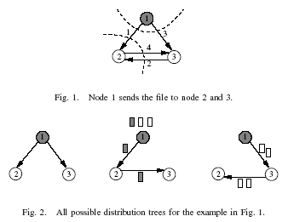
The Problem
Given:
  A graph where each edge is associated with a capacity
  A set of multicast sessions
  For each multicast session, there is a set of spanning trees
Minimize total downloading time
The problem is equivalent to the problem of the problem of packing Steiner trees.

Slide 3
Background and Motivation
P2P is more and more used as a technique for massive content distribution
The technique used by this paper is known as swarming
  Divide the files into chunks
  Spread them out through the peers
  Peers can exchange the chunks to speed up the process.

Slide 4
Approaches
The problem can be formulated to a non-linear programming problem and it can be solved by a gradient-based algorithm
Objective:
  To maximize throughput
Subject to:
  The capacity constraint: the total rate on a given link cannot exceed the max capacity of the link
The problem can be solved by using a gradient-base algorithm called Diagonally Scaled Gradient Projection Algorithm.

Slide 5
Technique
The key techniques used in the algorithm contains three cases
  If a tree is not the chosen minimum-cost tree (with index is(k)) and ithas a positive flow, its rate will be reduced.
  If a tree is not the chosen minimum-cost tree and the tree has zero flow rate, then the rate stays at 0.
  If a tree is the chosen minimum-cost tree, the rate of the tree is increased so that the total rates of all trees rooted at s will be equal to the demanded rate r_{s}.

Slide 6
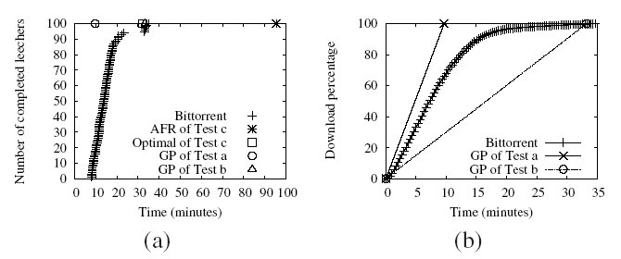
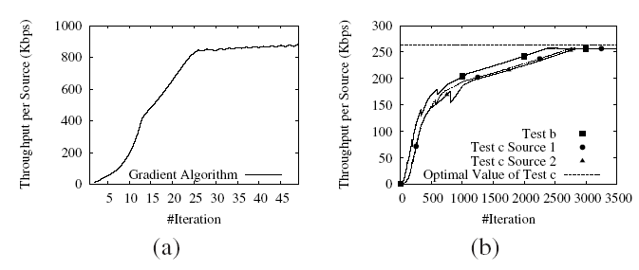
Results
Better throughput
Good Convergence

